Slide 1
Deep Learning
Anshu Pandey

Slide 2

Agenda
Deep Learning Introduction
Deep Learning v/s Machine Learning
Convolutional Neural Network
Example 1 – MNIST-CNN using keras

Slide 3
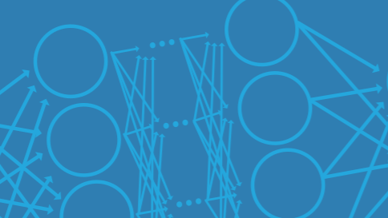
What is Deep Learning?
Deep learning is a type of machine learning in which a model learns to perform classification tasks directly from images, text, or sound.
Deep learning is usually implemented using a neural network architecture.
The term “deep” refers to the number of layers in the network—the more layers, the deeper the network. Traditional neural networks contain only 2 or 3 layers, while deep networks can have hundreds.

Slide 4
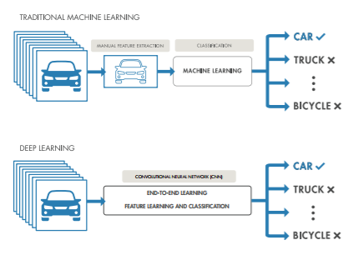
What is the Difference Between Deep Learning and Machine Learning?
Deep learning is a subtype of machine learning. With machine learning, you manually extract the relevant features of an image.
With deep learning, you feed the raw images directly into a deep neural network that learns the features automatically.

Slide 5
What is the Difference Between Deep Learning and Machine Learning?
Machine Learning | Deep Learning
+ Good results with small datasets | - Requires very large data sets
+ Quick to train a model | - Computationally Intensive
- Need to try different features and classifiers to achieve best results. | + Learns features and classifiers automatically
- Accuracy plateaus | + Accuracy is unlimited

Slide 6
Deep Learning Applications
Deep learning is especially well-suited to identification applications such as face recognition, text translation, voice recognition, and advanced driver assistance systems, including, lane classification and traffic sign recognition.
Here are just a few examples of deep learning at work:
A self-driving vehicle slows down as it approaches a pedestrian crosswalk.
An ATM rejects a counterfeit bank note.
A smartphone app gives an instant translation of a foreign street sign.

Slide 7
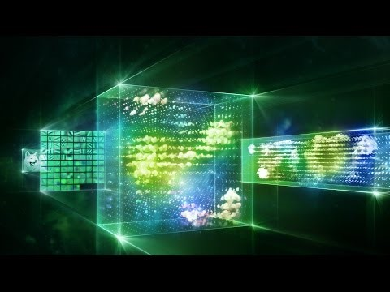

Slide 8
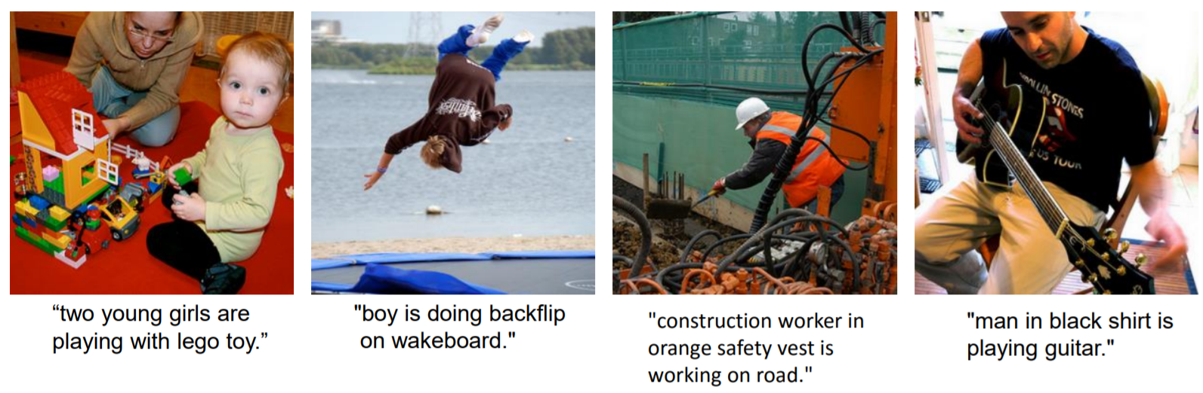
Image Captioning

Slide 9
Computational Resources for Deep Learning
Training a deep learning model can take hours, days, or weeks, depending on the size of the data and the amount of processing power you have available.
Currently, there are three computation options: CPU-based, GPUbased, and cloud-based.
CPU-based computation is the simplest and most readily available option. Using CPU-based computation only for simple examples using a pretrained network.
Using a GPU reduces network training time from days to hours.
Cloud-based GPU computation means that you don’t have to buy and set up the hardware yourself.

Slide 10
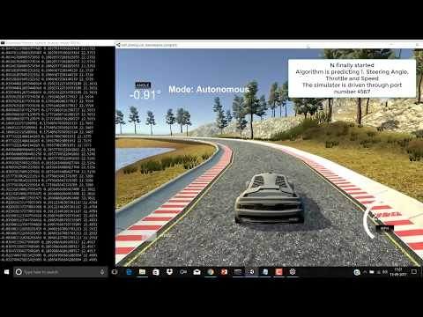
Self Driving Car Simulation using CNN

Slide 11
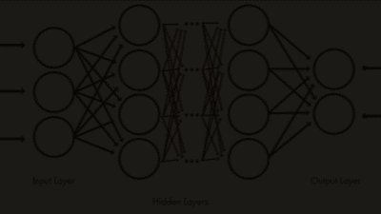
Inside a Deep Neural Network
A deep neural network combines multiple nonlinear processing layers, using simple elements operating in parallel and inspired by biological nervous systems.
It consists of an input layer, several hidden layers, and an output layer. The layers are interconnected via nodes, or neurons, with each hidden layer using the output of the previous layer as its input.

Slide 12
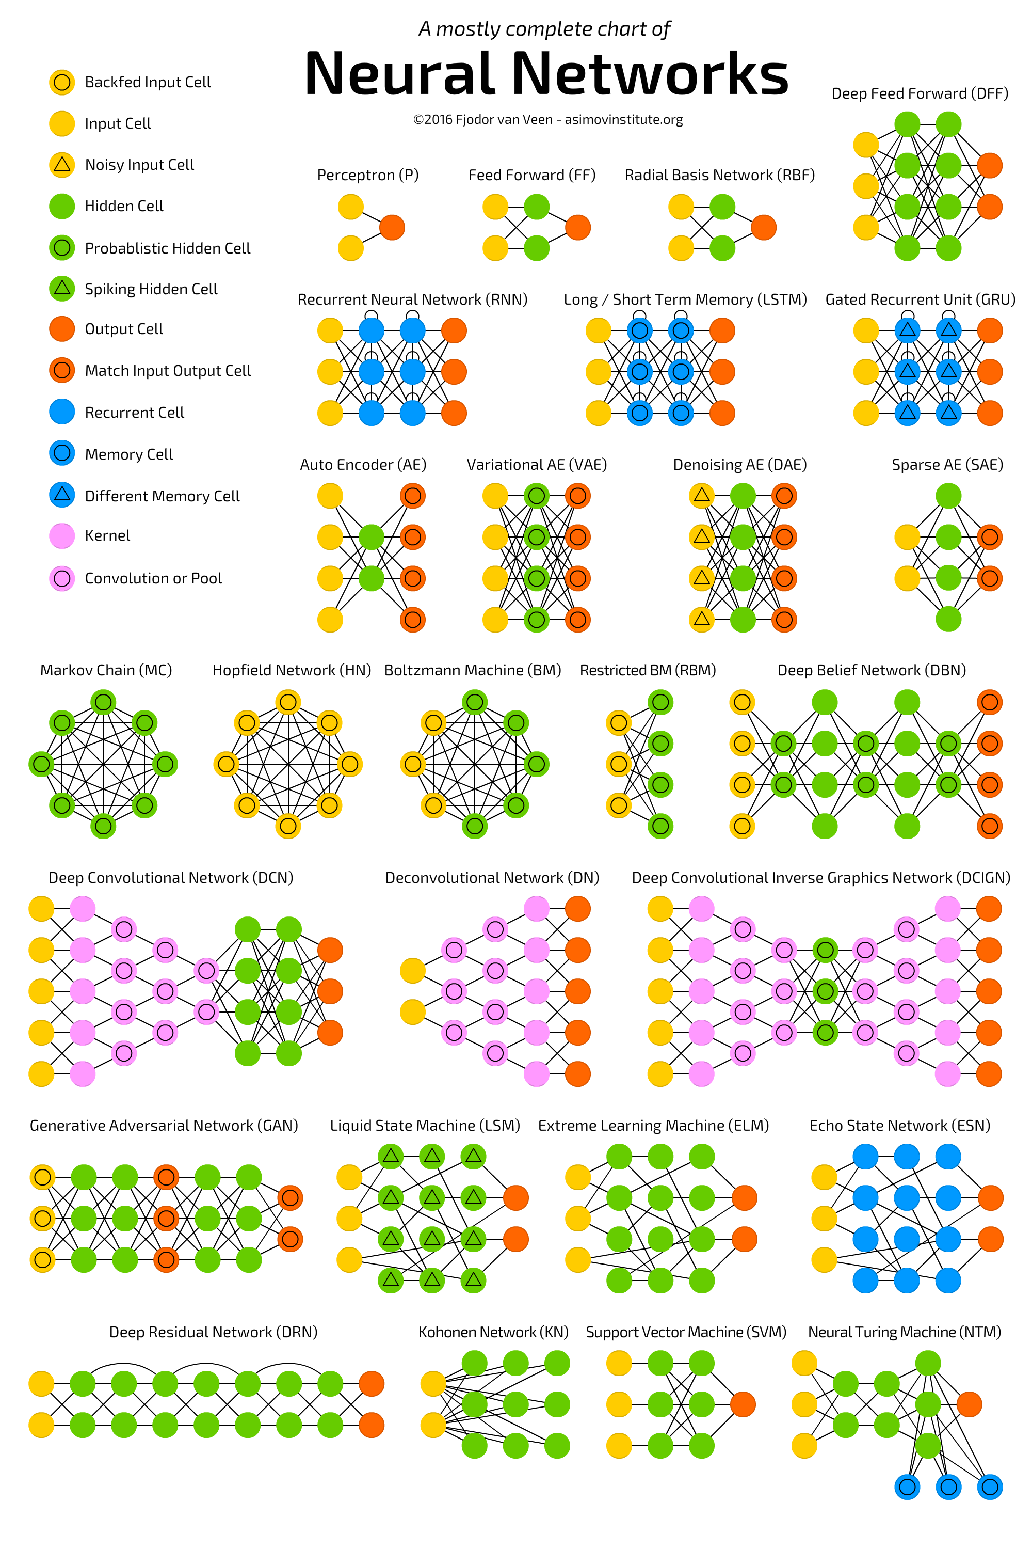

Slide 15
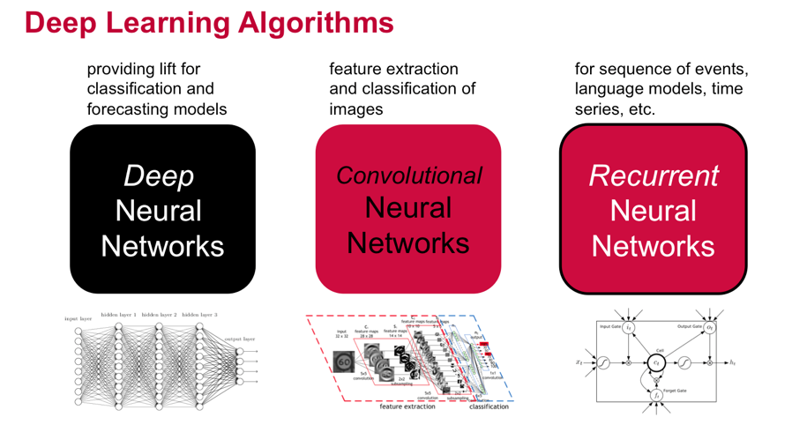

Slide 16
Use cases
Text Processing ( Sensitivity Analysis, Named Entity recognition)
- RNTN (Recursive Neural Tensor Network) OR Recurrent Net
Image Recognition – DBN(Deep Belief Network), Convolution Net
Object Recognition – RNTN, Convolution Net
Speech Recognition - Recurrent Net

Slide 17
For Projects http://cs229.stanford.edu/projects2013.html
For python Libraries http://www.lfd.uci.edu/~gohlke/pythonlibs/
For ML Data http://archive.ics.uci.edu/ml/index.php
Scikit-Learn http://scikit-learn.org/stable/
Data Mining Book https://www.amazon.com/dp/0123748569

Slide 18

Thank you
Anshu Pandey
https://www.linkedin.com/in/anshupandey/

